Slide 1
Product Life Cycle

Slide 2
Products, like people, have life cycles.
All products have certain length of life during which they pass through certain identifiable stages.
The PLC is a conceptual representation of product ageing process.
The product life cycle is broken into four stages:
Introduction,
Growth,
Maturity, and
Decline.

Slide 3
Definitions
According to Philip kotler:
“The Plc is an attempt to recognize the distinct stages in the sales history of the product”

Slide 4
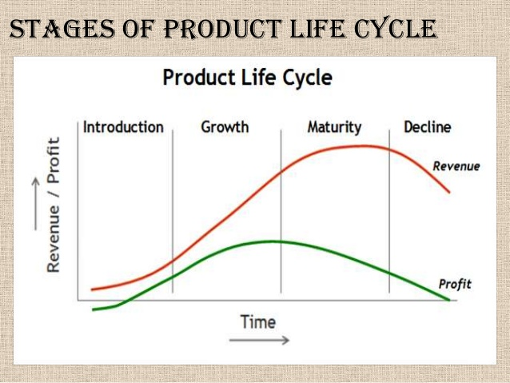

Slide 5
Introduction,
Once a product has been developed, the first stage is its introduction stage.
In this stage, the product is being released into the market This stage of the cycle could be the most expensive for a company launching a new product.
The size of the market for the product is small, which means sales are low, although they will be increasing.
On the other hand, the cost of things like research and development, consumer testing, and the marketing needed to launch the product can be very high, especially if it’s a competitive sector.

Slide 6
Growth
By the growth stage, consumers are already taking to the product and increasingly buying it.
The growth stage is typically characterized by a strong growth in sales and profits, and because the company can start to benefit from economies of scale in production, the profit margins, as well as the overall amount of profit, will increase.
Other companies become aware of the product and its space in the market, which is beginning to draw attention and increasingly pull in revenue. If competition for the product is especially high, the company may still heavily invest in advertising and promotion of the product to beat out competitors

Slide 7
Maturity
During the maturity stage, the product is established and the aim for the manufacturer is now to maintain the market share they have built up.
This is probably the most competitive time for most products and businesses need to invest wisely in any marketing they undertake.
They also need to consider any product modifications or improvements to the production process which might give them a competitive advantage.

Slide 8
Decline
Eventually, the market for a product will start to shrink, and this is what’s known as the decline stage.
This shrinkage could be due to the market becoming saturated (i.e. all the customers who will buy the product have already purchased it), or because the consumers are switching to a different type of product.
While this decline may be inevitable, it may still be possible for companies to make some profit by switching to less-expensive production methods and cheaper markets.

Slide 9
THANKYOU☺☺

